Slide 1
Fluid and Electrolyte Disorders

Slide 2
Total Body Water-TBW
TBW as a percentage of body weight varies with age.
Term Neonate has high TBW- 75% of birth weight.
Premature infants have higher TBW than term infants.
During the 1st yr of life, TBW decreases to 60% of body weight and remains at this level until puberty

Slide 3
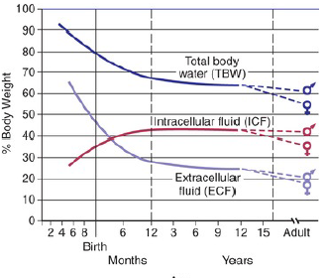
Cont’D

Slide 4
Fluid Compartments..
TBW has 2 main compartments:- Intracellular fluid(ICF) and extracellular fluid (ECF).
In the fetus and newborn, the ECF volume is larger.
By 1 yr of age, the ratio of ICF volume to ECF volume approaches adult levels.
The ECF volume is approximately 20–25% of body weight,
The ICF volume is approximately 30–40% of body weight, close to twice the ECF volume

Slide 5
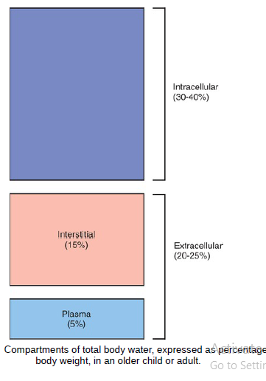
Fluid Compartment

Slide 6
Cont’D
A delicate equilibrium between the intravascular fluid and the interstitial fluid exists.
The balance between hydrostatic and oncotic forces regulates the intravascular volume.
There is usually a net movement of fluid out of the intravascular space to the interstitial space,

Slide 7
Electrolyte Composition
The composition of the solutes in the ICF and ECF are very different.
Na+ and Cl− are the dominant cation and anion, respectively, in the ECF.
Potassium (K+ ) is the most abundant cation in the ICF.
Proteins, organic anions, and phosphate are the most plentiful anions in the ICF.

Slide 8
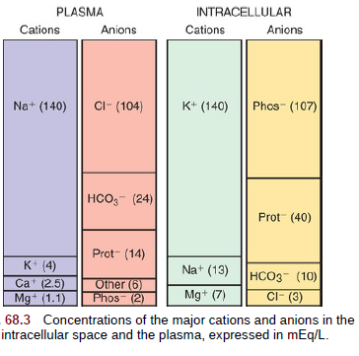
Electrolyte Composition

Slide 9
Electrolyte Functions
Regulate water distribution
Muscle contraction
Nerve impulse transmission
Blood clotting
Regulate enzyme reactions (ATP)
Regulate acid-base balance

Slide 10
Osmolality…
The ICF and the ECF are in osmotic equilibrium.
If the osmolality in 1 compartment changes, then water movement leads to a rapid equalization of osmolality.
The ECF osmolality can be determined and usually equals ICF osmolality.
The Plasma osmolality is normally 285-295 mOsm/kg.

Slide 11


Plasma Osmolality

Slide 12
Hyperglycemia Vs Hyponatremia?
Hyperglycemia causes an increase in the plasma osmolality.
Dilution of the Na+ in the ECS.
Hyponatremia despite elevated plasma osmolality
The [Na]corrected is the more reliable indicator of the ratio of total body Na+ to TBW.

Slide 13
Maintenance fluid and electrolyte needs
Maintenance fluid needs: the quantity of intake that will provide the fluid necessary to match fluid losses.
Maintenance fluids should contain water, glucose, Na+ and K+

Slide 14
Goals of maintenance fluids
Prevent dehydration
Prevent electrolyte disorders
Prevent ketoacidosis
Prevent protein degradation

Slide 15
Composition of Intravenous Solutions in mEq/l
Fluid | Na+ | K+ | Cl- | Ca++ | lactate
0.9% NaCl (NS) | 154 | - | 154 | - | -
0.45% NaCl (half NS) | 77 | - | 77 | - | -
0.2% NaCl (NS) | 34 | - | 34
Ringers lactate (RL) | 130 | 4 | 109 | 3 | 28

Slide 16
Maintenance requirements
Maintenance Fluids: weight dependent & age dependent:
Isotonic fluids with 5% dextrose are recommended as standard maintenance fluid except in neonates.
Isotonic fluid:D5 +NS + 10-20 mEq KCl

Slide 17
Maintenance fluid and electrolyte needs

Slide 18
Replacement of ongoing losses in diarrhea
In diarrheal disease (expected losses Na+55 mEq/L, K+ 25 mEq/L, HCO3 15 mEq/L)
Fluid of choice ORS
If IV: D5+half NS+30 mEq HCO3+20 mEq/L of KCL
Replace stool ml/ml

Slide 19
Ongoing losses in vomiting
Estimated losses in hypertrophic pyloric stenosis (Na+ 60 mEq/L, Cl- 90 mEq/L, K+ 10 mEq/L)
Solution: NS + 10 mEq/L of KCl
Replace vomiting ml/ml

Slide 20
Ongoing losses in altered RF
Oliguria or anuria
Insensible fluid losses (25-40% of the maintenance) with D5 + half NS + KCl or orally
Volume for volume replacement of urine
Polyuric states
Replace insensible loss (25-40% of maintenance) with D5 +half normal saline + KCl
Replace urine output volume for volume

Slide 21
Dehydration
Epidemiology:
One of the most common medical problems

Slide 22
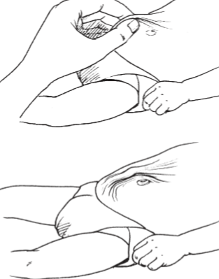
Estimation of the degree of DHN
4 key signs:
Mental status
Thirst
Eye signs
Skin pinch

Slide 23
Classification of the degree of DHN
NO dehydration (< 5% loss)
Some dehydration (6-9% loss)
Severe dehydration (> 10% loss)

Slide 24
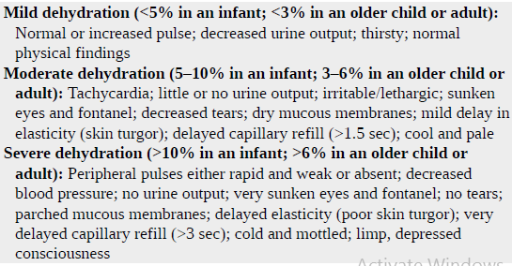
Clinical Evaluation of Dehydration

Slide 25
Classification of dehydration: Two signs needed
Parameter | No dehydration | Some dehydration | Severe dehydration
Mental status | Alert | Restless, irritable | Lethargic or unconscious
Eye ball | No sunken eyes | sunken eyes | sunken eyes
Drinking | Drinking normally | Eager to drink | Unable to drink
Skin turgor | Normal skin turgor | Skin pinch returns slowly | Skin pinch returns very slowly

Slide 26
Management of dehydration
1. No DHN– Mx plan A
Treat diarrhea at home:
Rules of 3 ‘Fs’
1. Give extra FLUID
2. Continue FEEDING
3. When to come for FOLLOW UP

Slide 27
Cont…
Fluid – in addition to the usual fluid intake
give ORS: 10ml/kg
OR
50-100ml for those below 2yrs per bowel
100-200ml for children > 2yrs motion
Other fluids; breast milk, food-based fluids(soup, rice water,yogurt) or clean water

Slide 28
Cont…
Feeding- frequent breast feeding
-cow’s milk or formula
- continue other foods if he started
Return/follow up-see him in 2days
come back immediately if the child becomes sick(unable to drink,sicker,fever,dysentery)

Slide 29
Cont…
B. Some DHN– plan B, loss is estimated to be 5%(average)
Treat with ORS:
Volume is 75ml/kg
Give over 4hrs
Continue breast feeding
If vomiting, wait for 10minutes
After 4hrs, reassess and classify DHN

Slide 30
Cont…
C. Severe DHN-
treatment plan C-loss estimated to be 10% of body weight
Start IV immediately
Ringer’s lactate or NS
Volume is 100ml/kg

Slide 31
Mx of severe dehydration
Infants (below 12months of age) | 1st give 30ml/kg over 1hour (repeat if no response *) | Then give 70ml/kg over 5hrs
Children>12months of age | Over 30minutes (repeat if no response *) | Over two and half hours

Slide 32
Cont…
Zink supplementation
reduce duration and severity of diarrhea
increased use of ORS and reduction in the inappropriate use of antimicrobials
10 mg/day for infants <6 mo of age and 20 mg/day for those >6 mo for 10 days

Slide 33
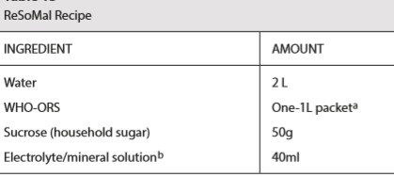
Mx of DHN in SAM
Children with SAM and some or severe dehydration but not in shock:
5 mL/kg ReSoMal every 30 min for the first 2 h. Then, if the child is still dehydrated, 5–10 mL/kg/h ReSoMal should be given in alternate hours with F-75, up to a maximum of 10 hr

Slide 34
Common Electrolyte Disturbances

Slide 35
Sodium
Sodium is the dominant cation of the ECF.
Is the principal determinant of extracellular osmolality.
Na+ is necessary for the maintenance of intravascular volume.

Slide 36
Cont’d
135-145mEq/L
Regulates volume of body fluids
Needed for nerve impulse & muscle fiber transmission (Na/K pump)
Reabsorption in renal tubule regulated by:-
Aldosterone
Renin/angiotensin

Slide 37
Aldosterone: Released from the adrenal cortex
Decrease circulating volume
Stimulated by R-A-A-S
Increase plasma K
Enhanced renal reabsorption of Na in exchange for K (increase Na = expansion of ECF)
ANP: secreted by the cardiac atrium in response to atrial dilatation (regulates blood volume)
Inhibits Renin secretion
Increase GFR and Na excretion

Slide 38
Hypernatremia

Slide 39
Hypernatremia…
Plasma Na+ > 145 mEq / L
Excess Na intake (hypertonic IV solution)
Due to ↑ Na + or ↓ water
Water moves from ICF → ECF
Cells dehydrate
Na+
Na+
Na+
Cell
H₂O

Slide 40
Causes of Hypernatremia
2. Water Deficit
Nephrogenic Diabetes Insipidus
Central DI
Increased Insensible Losses
Premature infants
Radiant warmers
Phototherapy
Inadequate intake
1. Excessive Sodium
Improperly mixed formula
Excess sodium bicarbonate
Ingestion of seawater or sodium chloride
Intentional salt poisoning
Intravenous hypertonic saline
Hyperaldosteronism

Slide 41
Cont’D
3. Water and Sodium Deficits
Gastrointestinal Losses
Diarrhea
Emesis/nasogastric suction
Osmotic cathartics (lactulose)
Cutaneous Losses
Burns
Excessive sweating
Renal Losses
Osmotic diuretics (mannitol)
Diabetes mellitus
Chronic kidney disease (dysplasia and obstructive uropathy)
Polyuric phase of acute tubular necrosis
Post obstructive diuresis

Slide 42
Clinical Manifestations..
Hypernatremia Asymptomatic
Symptomatic (Na>160 meq/L)

Slide 43
Clinical Manifestations of Abnormalities in Serum Sodium
Central nervous system -- Restlessness, lethargy, ataxia , irritablity ,delirium, seizures, coma
Musculoskeletal -- weakness
Cardiovascular -- Tachycardia, hypotension, syncope
Tissue -- Dry sticky mucous membranes, red swollen tongue ,decreased saliva and tears
Renal -- Oliguria
Metabolic --fever
Notes:
.

Slide 44
Hypernatremic Dehydration
The history usually suggests the etiology of the dehydration :- isotonic dehydration, hyponatremic dehydration, or hypernatremic dehydration.
The degree of dehydration is underestimated in hypernatremic dehydration

Slide 45
Approach to Severe Dehydration
Acute intervention to ensure adequate tissue perfusion.
Rapid restoration of the circulating intravascular volume

Slide 46
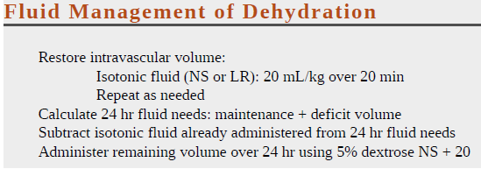
Treatment…

Slide 47
Cont’D
Calculate the free water deficit
Correct the free water deficit at a rate of 0.5 -1mEq/L/hr
Check serum Na q4hr
Use isotonic salt-free IV fluid

Slide 48
Water deficit (L)= × TBW
The formula used to estimate the amount of water required to correct hypernatremia:-
Serum sodium-140
140

Slide 49
Water Deficit
Water Deficit= ([serum Na/140]-1) x TBW
Example 20 kg male, serum Na= 160
Water deficit= ([160/140]-1)x 0.6x 20
= 0.14 x 0.6x 20
= 1.7 L

Slide 50
Cont’D
Only half of the water deficit should be corrected in the first 24 hours.
In most clinical situations, the total deficit will require replacement over the next 24 - 72 hours
Decrease Na concentration at a rate of 0.5 mEq/hr ~ 10 mEq/day.
Faster correction can result in Cerebral Edema

Slide 51
Hypernatremic Dehydration
Is the most dangerous form of dehydration
Hypernatremia can cause serious neurologic damage, including central nervous system hemorrhages and thrombosis

Slide 52
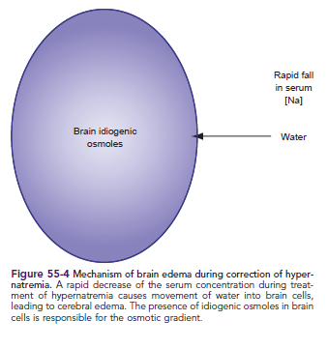
Cont’d

Slide 53
Treatment Complications
To minimize the risk of cerebral edema, the serum sodium concentration should not decrease by >10 mEq/L every 24 hr.
Overly rapid treatment of hypernatremic dehydration may cause significant morbidity and mortality.

Slide 54
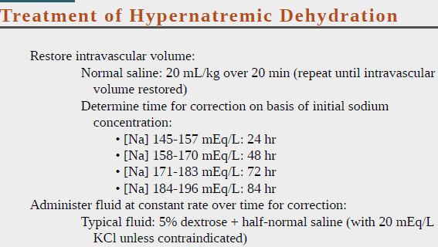
Cont’D

Slide 55
Cerebral Edema…
Seizures and a depressed level of consciousness are the most common manifestation.
Signs of increased intracranial pressure or impending herniation may develop quite rapidly.
Acutely, increasing the serum [Na+ ] through an infusion of 3% sodium chloride can reverse the cerebral edema.
Each 1 mL/kg of 3% NaCl increases the serum [Na+ ] by approximately 1 mEq/L.
An infusion of 4 mL/kg often results in resolution of the symptoms

Slide 56
Hyponatremia
Cont’D

Slide 57
Hyponatremia: Na<135mEq/L
Causes :
1. Sodium depletion
2. Sodium dilution

Slide 58
Sodium depletion
1. Decrease intake
􀂄Low Na diet
􀂄Enteral feeds
2. Increase loss
Gastrointestinal Losses
􀁻Vomiting
􀁻Prolonged NGT suctioning
􀁻Diarrhea
Renal Losses
􀁻Diuretics
􀁻Primary renal disease
3. Depletional hyponatreamia is often accompanied by extracellulr volume deficit

Slide 59
Sodium dilution
1. Due to excess extracellular water
􀂄Intentional: excessive oral intake
􀂄Iatrogenic: Intravenous
2. Drugs
􀂄Antipsychotics
􀂄Tricyclic antidepressants
􀂄Angiotensin-converting enzyme inhibitors
3. Hyperosmolar
􀁻Mannitol
􀁻Hyperglycemia
- For every 100 mg/dL increment in plasma glucose above normal, the plasma sodium should decrease by 1.6 mEq/L.
4.Pseudohyponatremia
􀁻Plasma lipids
􀁻Plasma proteins

Slide 60
Hyponatremia…
Hypovolemic hyponatremia
Renal losses caused by diuretic excess, osmotic diuresis, adrenal insufficiency…..
Extra renal losses caused by vomiting, diarrhea, sweat, and third spacing
Rx: Volume resuscitation with NS

Slide 61
Hyponatremia
Normovolemic hyponatremia
When hyponatremia is caused by SIADH, reset osmostat, glucocorticoid deficiency, hypothyroidism, or water intoxication(psychogenic polydipsi)
Rx:
Fluid restriction
Correct endocrine abnormality

Slide 62
Hyponatremia
Hypervolemic hyponatremia
If hyponatremia is caused by an edema-forming state (eg, congestive heart failure, cirrhosis, nephrotic syndrome)
If hyponatremia is caused by acute or chronic renal failure
Rx: Correct underlying state

Slide 63
Sign and symptoms
CNS symptom when Na<120 meq/l
Cardiac symptom when Na<100 meq/l

Slide 64
Cont’D
Acute Hyponatremia (<24 hours)
Early Onset (Serum Sodium <125 meq/L)
- Nausea
- Vomiting
- Headache
Later or Severe (Serum Sodium <120 meq/L)
Seizure
Coma
Respiratory arrest

Slide 65
Cont’D
Chronic Hyponatremia (>48 hours)
Lethargy
Confusion
Muscle cramps
Neurologic Impairment

Slide 66
Cont’D
Body System Hyponatremia
central nervous system Headache, confusion, hyper-or hypoactive deep tendon
reflexes, seizures, coma, increased intracranial pressure
Musculoskeletal Weakness, fatigue, muscle cramps/twitching
Gastrointestinal Anorexia, nausea, vomiting, watery diarrhea
Cardiovascular Hypertension and bradycardia if significant increases in
intracranial pressure
Tissue Lacrimation, salivation
Renal Oliguria

Slide 67
Hyponatremia Treatment
The initial goal is correction of intravascular volume depletion with isotonic fluid.
An overly rapid (>12 mEq/L over 1st 24 hr) or overcorrection in the serum [Na+ ] (>135 mEq/L) is associated with an increased risk of central pontine myelinolysis.

Slide 68
Treatment
Asymptomatic : increase the sodium level by no more than 0.5-1 meq/L/h to a maximum increase of 12 meq/L per day
Symptomatic: (Na<120 meq/L) Increase the sodium level by no more than 1meq/L per hour until the serum Na level reaches 130 meq/L or neurologic symptoms are improved

Slide 69
Cont’D
Na Deficit = (Na Desired - Na observed) x 0.6 x body weight(kg)
Replace half in first 8 hours and the rest in the following 16 hours

Slide 70
Cont’D
In cases of severe hyponatremia (<120 mEq) with CNS symptoms:-
3% NaCl 3-5 ml/kg IV push for hyponatremia induced seizures
6 ml/kg of NaCl will raise serum Na by 5 mEq/L

Slide 71
Complications of treatment
Na ⁺
Na⁺
H₂O Na⁺
Na⁺
H₂O
Na ⁺
H₂O
Na ⁺
H₂O
Pontine myelinolysis

Slide 72
Cont’D
Rapid correction of hyponatremia
↓
Pontine myelinolysis
↓
Seizures, weakness/paresis, akinetic movements, unresponsiveness
↓
Permanent brain damage
↓
Death

Slide 73
Potassium

Slide 74
Potassium
Most abundant intracellular cation
Normal serum values 3.5-5.5 mEq
Abnormalities of serum K are potentially life-threatening due to effect in cardiac function.
HYPOKALEMIA and HYPERKALEMIA

Slide 75
Hyperkalemia Causes
Increased intake
Potassium supplementation
Blood transfusions
Endogenous load/destruction:
hemolysis, rhabdomyolysis,
cruch injury, gastrointestinal hemorrhage
Increased release
Acidosis
Rapid rise of extracelulare osmolality (hyperglycemia or mannitol)
Impaired excretion of potassium
Renal insufficiency/failure

Slide 76
Clinical manifestation of hyperkalemia
System Clinical Presentations
Gastrointestinal Nausea/vomiting ,colic, diarrhea
Neuromuscular weakness, paralysis, respiratory failure
Cardiovascular Arrhythmia, arrest
ECG changes Peaked T waves (early change)
Flattened P wave
Prolonged PR interval (first-degree block)
Widened QRS complex
Sine wave formation
Ventricular fibrillation

Slide 77
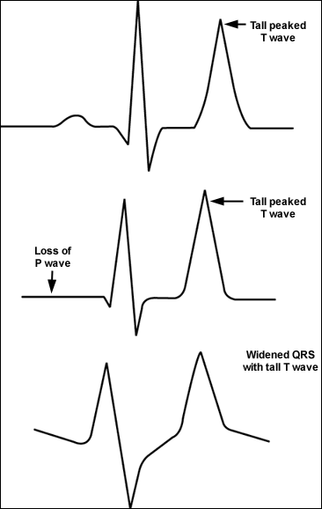
Hyperkalemia ECG

Slide 78
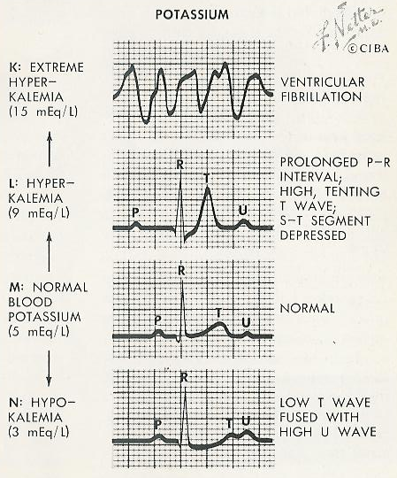

Slide 79
Approach to Hyperkalemia
Step 1: Is it real?
Assess for/exclude pseudo hyperkalemia
Hemolysis—ask the nurse/phlebotomist/lab tech
If suspected— repeat K⁺ level
Potassium infusion—ask the nurse
If suspected—repeat K⁺ level from peripheral vein AWAY from infusion site

Slide 80
Approach to Hyperkalemia
Step 2: If real, why did it happen?
Acute or chronic renal failure
Medications (K⁺ sparing diuretics, ACE inhibitors, ARB’s, BB’s, digoxin, etc.)
Endocrinopathies
K⁺ supplements or salt substitutes
K⁺ in IV infusions/TPN
GI losses..

Slide 81
Approach to Hyperkalemia
Step 3 (con’t): EKG assessment
Four stages of EKG changes
Peaked T waves
PR prolongation
QRS widening
Sine waves
Pulseless electrical activity or asystole

Slide 82
Approach to Hyperkalemia…
Step 4: Emergency Rx
Part A: oppose toxic effects on cell membrane
IV calcium infusion (gluconate preferred over chloride)
Less toxic effects if IV extravasation
Give 1-2ml/kg, 10mL ampules of 10% Calcium gluconate over 2-5 minutes
Keep EKG machine attached to patient!!!
EKG changes will diminish in 1-3 minutes
Action: Stabilization of cardiac cells. Does not lower potassium.
Used for hyperkalemia with EKG changes.
If EKG changes do not immediately resolve, dose can be repeated in 5 minutes.

Slide 83
Approach to Hyperkalemia
Step 4 (con’t): Emergency Rx
Part B: Shift K⁺ into cells
Insulin/dextrose therapy
Give 0.1iU/kg regular insulin IV push, together with 1 ampule (50mL) D50 IV push
Follow this with a D 5 containing IV maintenance fluid for several hours.
Effect within 15 minutes.
Peak effect 60 min. Duration 3-4 hours.
Adjuncts
Beta agonist:
Albuterol nebulizer
Peak effect in 90 minutes
Sodium bicarbonate 1 ampule IV push
Onset: 30 minutes
Duration: 60-120 minutes

Slide 84
Approach to Hyperkalemia
Step 5: Emergency or non-emergency therapy (usually takes 4-6 hours to work)
Direct elimination of K⁺ from body
Sodium polystyrene sufonate (K⁺ binding resin) plus sorbitol
Give Kayexalate 30-60 gm
PO if patient can tolerate
PR (retention enema) if upper GI problems
Patient needs to have a colon for this to work!
Hemodialysis as last resort or in severe cases

Slide 85
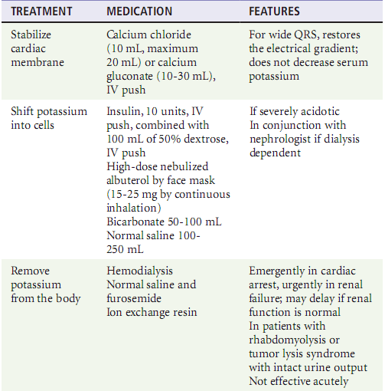
CONT’D

Slide 86
Summary: Hyperkalemia
Make sure it’s real
Determine emergent or not
Degree of hyperkalemia, EKG
Treat emergent cases with calcium gluconate, insulin, dextrose, and kayexalate +/- dialysis
Monitor closely for response to treatment—watch for rebound
Fix the cause if possible

Slide 87
Hypokalemia

Slide 88
Hypokalemia
K < 3.5 mEq/L

Slide 89
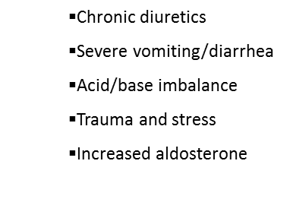
Pathophysiology of hypokalemia
Deficient intake (Poor potassium intake)
Due to a shift from extracellular to intracellular
Increased excretion
Renal
Extra renal

Slide 90
Magnesium..
Magnesium Depletion
(drug induced: amphotericin, amioglycosides, cisplatin)
↓
Renal potassium wastage
↓
Hypokalemia

Slide 91
Clinical Manifestation of Abnormalities in potassium
System hypokalemia
Gastrointestinal Ileus, constipation
Neuromuscular Decreased reflexes, fatigue, weakness,
paralysis
Cardiovascular Arrest
ECG changes U-waves
T-wave flattening
ST-segment changes
Arrhythmias

Slide 92
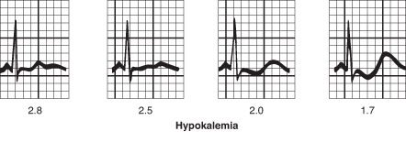
EKG Changes in Hypokalemia
Flattened T waves
ST depressions
Prominent U waves
Prolonged QT
Prolonged PR interval

Slide 93
Approach to Hypokalemia
Step 1: Redistribution or depletion?
Redistribution causes
Insulin therapy (usually in DKA)
Beta 2 agonists (e.g. albuterol)
Metabolic alkalosis
Replacement of potassium in these settings may lead to overshoot and hyperkalemia

Slide 94
Approach to Hypokalemia
Step 1: Redistribution or depletion?
Depletion causes (common)
GI tract losses (diarrhea, vomiting)
Loop/thiazide diuretic therapy
Other medications (e.g. amphotericin B)
Osmotic diuresis (DKA)
Endocrinopathies (mineralocorticoid excess)
Salt wasting nephropathies/RTA’s
Magnesium deficiency

Slide 95
Summary: Hypokalemia
PO almost always preferred over IV
KCl is preferred preparation
Don’t give too much too quickly
Be gentle in renal failure patients
Don’t forget to check magnesium levels in refractory patients

